Slide 1
UNIT 2 PARSING
Context Free Grammar
Derivation
CFG vs R.E.
Types of Parser
Bottom up: Shift Reduce Parsing, Operator Precedence Parsing, SLR parser
Top Down: Recursive Descent Parser - Non-Recursive Descent Parser.
SCS1303-Compiler Design

Slide 2
Syntax Analysis
Every programming language has rules that prescribe the syntactic structure of well-formed programs.
For example, in Pascal,
  a program is made out of blocks,
  a block out of statements,
  a statement out of expressions,
  an expressions out of tokens and so on.
The syntactic or the structural correctness of a program is checked during the syntax analysis phase of compilation.
The structural properties of language constructs can be specified in different ways.
SCS1303-Compiler Design

Slide 3
Different Formalisms
Syntax diagram (SD),
Backus-Naur form (BNF), or
Context-free grammar (CFG).
Different styles of specification have different purpose.
SD is good for human understanding and visualization.
The BNF is very compact. It is used for theoretical analysis and
also in automatic parser generating softwares.
The syntactic specification of a programming language, written as a context-free grammar can be used to construct its parser by synthesizing a push-down automaton (PDA).
SCS1303-Compiler Design

Slide 4
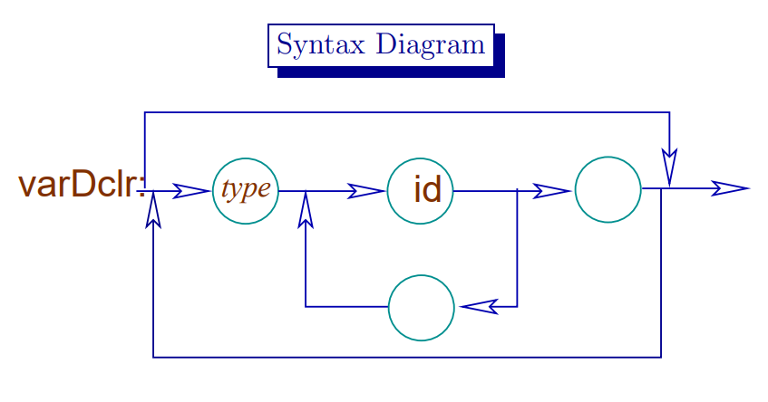
e.g.
Declaration statement
int a,b,c;
SCS1303-Compiler Design

Slide 5
Grammars offer significant advantages to both language designers and compiler writers.
Gives a precise, easy-to-understand, syntactic specification of a programming language.
From certain classes of grammars an efficient parser can be automatically constructed that determines if a source program is syntactically well formed.
A properly designed grammar imparts a structure to a programming language that is useful for translation of source code into correct object code and for detection of errors.
SCS1303-Compiler Design

Slide 6
Role of Parser
The parser obtains a string of tokens from the lexical analyzer and verifies that the string can be generated by the grammar.
The parser should report any syntax errors.
It should recover from errors so as to continue processing the remaining inputs.
Lexical Analyzer
token
Parser
Rest of front end
source
parse
intermediate
program
tree
representation
get next token
Symbol Table
SCS1303-Compiler Design

Slide 7
Role of Parser (contd..)
Three types of parsers for grammars:
  Universal Parsing method
    Cocke-Younger-Kasami Algorithm
    Earley’s Algorithm
  Top-down Parsing
    Build parse trees from the top(root) to the bottom(leaves)
  Bottom-up Parsing
    Build parse trees from the bottom(leaves) and work up to the root.
SCS1303-Compiler Design

Slide 8
Role of Parser (contd..)
Assume that the output of the parser is some representation of the parse tree for the stream of tokens produced by lexical analyzer.
Other majors tasks:
  Collecting information about various tokens into the symbol table.
  Performing type checking and other semantic analysis.
  Generating intermediate code.
SCS1303-Compiler Design

Slide 9
Syntax Error Handling
The programs can contain errors at different levels.
e.g. errors can be
  Lexical, such as misspelling of keywords, identifier or operator.
  Syntactic, such as an arithmetic expression with unbalanced parenthesis
  Semantic, such as an operator applied to an incompatible operand.
  Logical, such as an infinitely recursive call.
  The error detection and recovery in a compiler is centered around the syntax phase.
SCS1303-Compiler Design

Slide 10
Syntax Error Handling
The error handler in a parser has simple-to-state goals:
  It should report the presence of errors clearly and accurately.
  It should recover from each error quickly enough to be able to detect subsequent errors.
  It should not significantly slow down the processing of correct programs.
SCS1303-Compiler Design

Slide 11
Error-recovery strategies
Panic mode
  Discard input symbol one at a time until one of designated set of synchronization tokens is found.
Phrase level
  Replacing a prefix of remaining input by some string that allows the parser to continue.
Error productions
  Augment the grammar with productions that generate the erroneous constructs.
Global correction
  Choosing minimal sequence of changes to obtain a globally least-cost correction.
SCS1303-Compiler Design

Slide 12
Context Free Grammar(CFG)
SCS1303-Compiler Design

Slide 13
Context-Free Grammar(CFG)
Many programming language constructs have an recursive structure that can be defined by CFG,
e.g. Conditional Statement defined by a rule,
If S₁ and S₂ are statements and E is an expression ,then
“if E then S₁ else S₂ “ is a statement (1)
This form of conditional statement cannot be specified using the regular expression.
Grammar specifications:
With the use of syntactic variable:
stmt to denote the class of statements, and
expr to denote the class of expressions,
We can express (1) as a grammar rule,
stmt → if expr then stmt else stmt
SCS1303-Compiler Design

Slide 14
Context-Free Grammar(CFG)
CFG consists of terminals, non-terminals, start symbol, and productions.
Terminals:
  Basic symbols from which strings are formed. i.e Tokens are terminals.
Non-terminals:
  Syntactic variables that denote set of strings.
  Helps to define the language generated by the grammar.
Start symbol:
  One non-terminal that denotes the language defined by the grammar.
Productions:
  Specify the manner in which the terminals and non-terminals can be combined to form strings.
  Each production consists of a non-terminal , followed by an arrow→ , followed by a string of non-terminals and terminals.
SCS1303-Compiler Design

Slide 15
Example
Consider the grammar for simple arithmetic expressions:
expr → expr op expr
expr → ( expr )
expr → - expr
expr → id
op → +
op → -
op → *
op → /
op → ^
Terminals : id + - * / ^ ( )
Non-terminals : expr , op
Start symbol : expr
SCS1303-Compiler Design

Slide 16
Notational Conventions
These symbols are terminals:
  Lower-case letters early in the alphabet such as a, b, c.
  Operator symbols such as +, -, etc.
  Punctuation symbols such as parentheses, comma etc.
  Digits 0,1,…,9.
  Boldface strings such as id or if (keywords)
2. These symbols are non-terminals:
  Upper-case letters early in the alphabet such as A, B, C..
  The letter S, when it appears is usually the start symbol.
  Lower-case italic names such as expr or stmt.
SCS1303-Compiler Design

Slide 17
Notational Conventions(contd..)
Upper-case letters late in the alphabet, such as X,Y,Z, represent grammar symbols, that is either terminals or non-terminals.
Greek letters α , β , γ represent strings of grammar symbols.
  e.g a generic production could be written as A → α
  If A → α₁ , A → α₂ , . . . . , A → α_{n} are all productions with A , then we can write A → α₁ | α₂ |. . . . | α_{n} , (alternatives for A).
  Unless otherwise stated, the left side of the first production is the start symbol.
SCS1303-Compiler Design

Slide 18
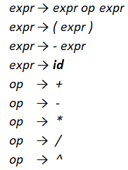
Using the shorthand, the grammar can be written as:
E → E A E | ( E ) | - E | id
A → + | - | * | / | ^
SCS1303-Compiler Design

Slide 19
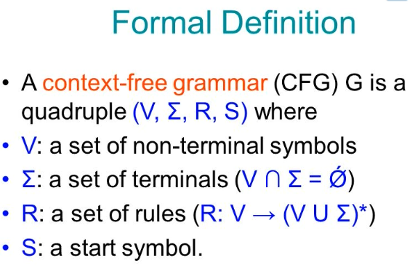
SCS1303-Compiler Design

Slide 20

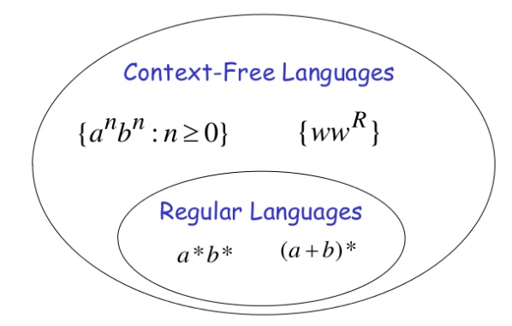
CFL vs RL
Any language that can be generated by a context free grammar is a context free language (CFL).
RL CFL – every regular language can be expressed by a CFG.
SCS1303-Compiler Design

Slide 21
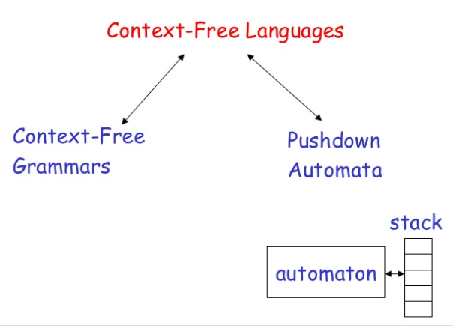
SCS1303-Compiler Design

Slide 22
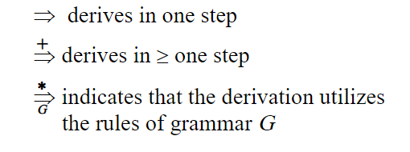
Derivations
A derivation of a string for a grammar is a sequence of grammar rule applications that transform the start symbol into the string. A derivation proves that the string belongs to the grammar's language.
SCS1303-Compiler Design

Slide 23
To create a string from a context-free grammar:
  Begin the string with a start symbol.
  Apply one of the production rules to the start symbol on the left-hand side by replacing the start symbol with the right-hand side of the production.
  Repeat the process of selecting non-terminal symbols in the string, and replacing them with the right-hand side of some corresponding production, until all non-terminals have been replaced by terminal symbols.
SCS1303-Compiler Design

Slide 24
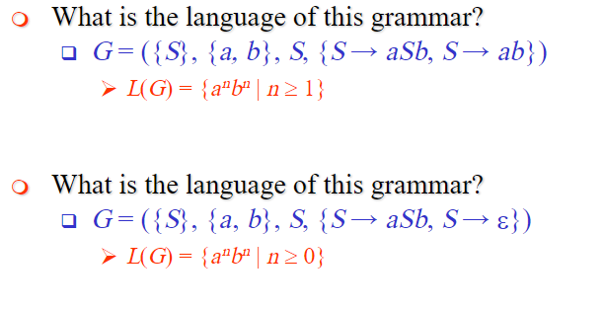
Example
SCS1303-Compiler Design

Slide 25
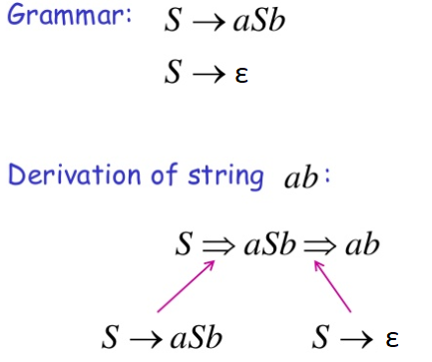
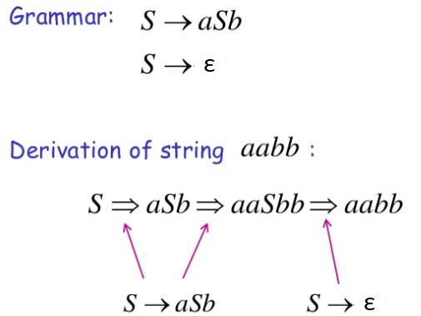
SCS1303-Compiler Design

Slide 26
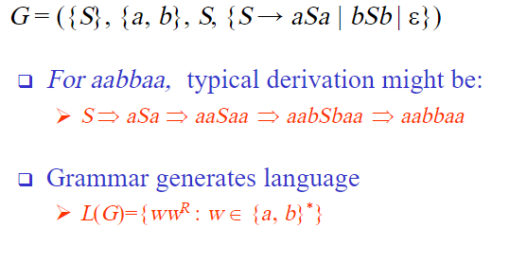
Example
SCS1303-Compiler Design

Slide 27
CFG: Parsing
Parser :
  A program that determines if a string w ϵ L(G) by constructing a derivation ,where G represent the grammar.
Top-down parsers :
  Constructs the derivation tree from root to leaves.
  Leftmost derivation.
Bottom-up parsers :
  Constructs the derivation tree from leaves to root.
  Rightmost derivation in reverse.
SCS1303-Compiler Design

Slide 28
Next Topic:
Derivations and Parse tree
SCS1303-Compiler Design

Slide 29
Derivations
A production is treated as a rewriting rule in which the non-terminal on the left is replaced by the string on the right side of the production.
e.g. Consider the grammar for arithmetic expression
E → E + E
E → E * E
E → ( E ) E → E + E | E * E | (E ) | - E | id
E → - E
E → id
SCS1303-Compiler Design

Slide 30

Consider the G,
E → E + E | E * E | (E ) | - E | id
Derive the string id + id * id
E => E + E
=> id + E
=> id + E * E
=> id + id * E
=> id + id * id
Each step of derivation is a Sentential Form
Sentence
SCS1303-Compiler Design

Slide 31

Context Free Language
Given a grammar G with start symbol S,
define L(G) ,the language generated by G.
i.e. Derives in one or more steps.
The string in L(G) contain only terminals.
A string of terminals w is in L(G) if and only if S w
where w is called the sentence of G.
If S α ,where α may contain non-terminals, then we say that α is a sentential form of G.
A sentence is a sentential form with no non-terminals.
SCS1303-Compiler Design

Slide 32
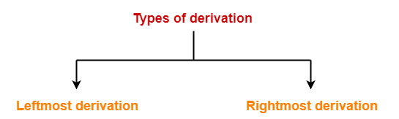
Derivations
A derivation is basically a sequence of production rules, in order to get the input string. During parsing, we take two decisions for some sentential form of input:
  Deciding the non-terminal which is to be replaced.
  Deciding the production rule, by which, the non-terminal will
  be replaced.
  To decide which non-terminal to be replaced with production rule, we can have two options.
SCS1303-Compiler Design

Slide 33
Types of Derivation
Leftmost Derivation(LMD):
If the sentential form of an input is scanned and replaced from left to right, it is called left-most derivation.
The sentential form derived by the left-most derivation is called the left-sentential form.
Rightmost Derivation(RMD):
If we scan and replace the input with production rules, from right to left, it is known as right-most derivation.
The sentential form derived from the right-most derivation is called the right-sentential form.
SCS1303-Compiler Design

Slide 34
Parse Tree or Derivation Tree
A parse tree is a graphical representation of a derivation sequence of a sentential form.
In a parse tree:
  All leaf nodes are terminals.
  All interior nodes are non-terminals.
  In-order traversal gives original input string.
A parse tree depicts associativity and precedence of operators.
The deepest sub-tree is traversed first, therefore the operator in that sub-tree gets precedence over the operator which is in the parent nodes.
SCS1303-Compiler Design

Slide 35

Example 1
Consider the G,
E → E + E | E * E | (E ) | - E | id
Derive the string id + id * id using leftmost derivation
E E + E
id + E
id + E * E
id + id * E
id + id * id
Parse Tree
E
E
+
E
id
E
*
E
id
id
SCS1303-Compiler Design

Slide 36

Example 1
Consider the G,
E → E + E | E * E | (E ) | - E | id
Derive the string id + id * id using rightmost derivation
E E + E
E + E * E
E + E * id
E + id * id
id + id * id
Parse Tree
E
E
+
E
id
E
*
E
id
id
SCS1303-Compiler Design

Slide 37
Example 2
Derive the string - ( id + id ) * id using rightmost /leftmost derivation.
Leftmost Derivation:
E E * E E * E
- E * E E * id
- ( E ) * E - E * id
- ( E + E ) * E - ( E ) * id
- ( id + E ) * E - ( E + E ) * id
- ( id + id ) * E - ( E + id ) * id
- ( id + id ) * id - ( id + id ) * id
E → E + E | E * E | (E ) | - E | id
SCS1303-Compiler Design

Slide 38
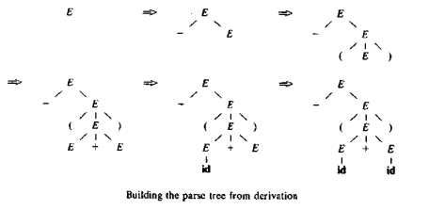
Example 3
Derive the string - ( id + id )
E - E
- ( E )
- ( E + E )
- ( id + E )
- ( id + id )
E → E + E | E * E | (E ) | - E | id
SCS1303-Compiler Design

Slide 39
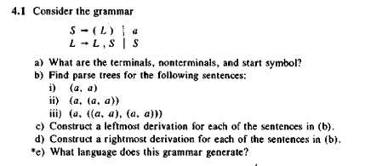
Practice
SCS1303-Compiler Design

Slide 40
Next Topic:
Ambiguity
SCS1303-Compiler Design

Slide 41
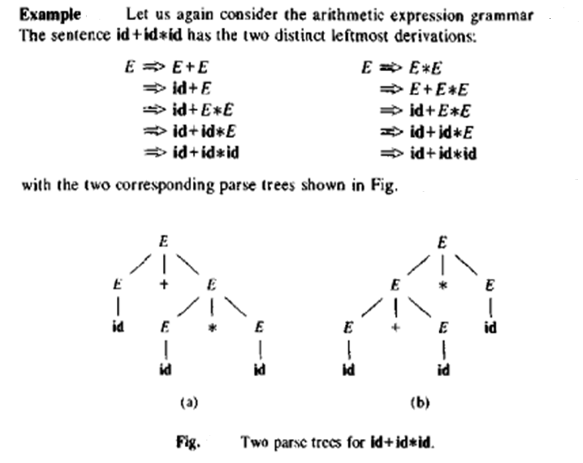
SCS1303-Compiler Design

Slide 42
Ambiguity
A grammar that produces more than one parse tree for some sentence is said to be ambiguous.
  i.e. An ambiguous grammar is one that produce more than one leftmost or more than one rightmost derivation for the same sentence.
  For certain types of parsers, it is desirable that the grammar be made unambiguous.
  We need to design unambiguous grammars for compiling applications.
SCS1303-Compiler Design

Slide 43
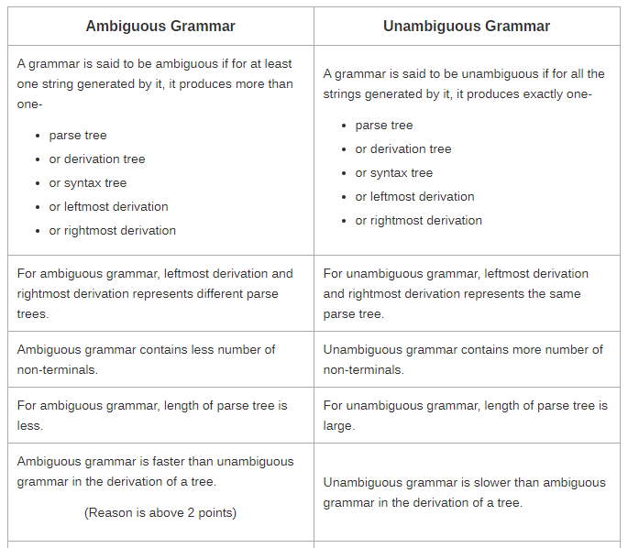
Ambiguous vs. Unambiguous
SCS1303-Compiler Design

Slide 44
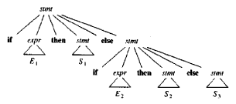
Eliminating Ambiguity
An ambiguous grammar can be rewritten to eliminate the ambiguity.
e.g. Eliminate the ambiguity from “dangling-else” grammar,
stmt → if expr then stmt
| if expr then stmt else stmt
| other
According to this grammar define a compound conditional statement,
SCS1303-Compiler Design

Slide 45
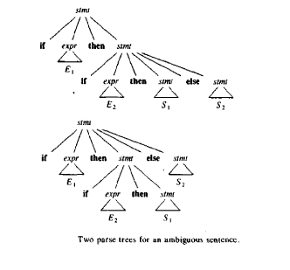
For the same grammar, consider the string,
The grammar is ambiguous since the string produces two parse tree,
SCS1303-Compiler Design

Slide 46

Match each else with the closest previous unmatched then.
This disambiguity rule can be incorporated into the grammar.
This grammar generates the same set of strings ,but allows only one parsing for string.
SCS1303-Compiler Design

Slide 47
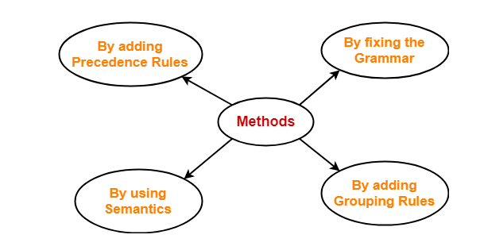
Methods To Remove Ambiguity
The ambiguity from the grammar may be removed using the following methods:
The solution to the problem of enforcing precedence is to introduce several different variables at each level of precedence.
SCS1303-Compiler Design

Slide 48
Removing Ambiguity by Precedence & Associativity Rules
An ambiguous grammar may be converted into an unambiguous grammar by implementing:
  Precedence Constraints
  Associativity Constraints
These constraints are implemented using the following rules:
Rule-1:
The level at which the production is present defines the priority of the operator contained in it.
  The higher the level of the production, the lower the priority of operator.
  The lower the level of the production, the higher the priority of operator.
Rule-2:
If the operator is left associative, induce left recursion in its production.
If the operator is right associative, induce right recursion in its production.
SCS1303-Compiler Design

Slide 49
Example
Consider the ambiguous Grammar:
E → E + E |E – E | E * E | E / E | (E) | id
Introduce new variable / non-terminals at each level of precedence,
  an expression E for our example is a sum of one or more terms. (+,-)
  a term T is a product of one or more factors. (*, /)
  a factor F is an identifier or parenthesised expression.
Unambiguous Grammar
E → E + T | E – T | T
T → T * F | T / F | F
F → (E) | id
SCS1303-Compiler Design

Slide 50
Unambiguous Grammar
E → E + T | T
T → T * F | F
F → (E) | id
Try deriving the string id+id*id using the above grammars.
E E + T
T + T
F + T
id + T
id + T * F
id + F * F
id + id * F
id + id * id
SCS1303-Compiler Design

Slide 51
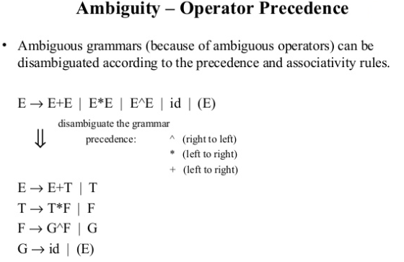
SCS1303-Compiler Design

Slide 52
RE vs. CFG
Every construct that can be described by a regular expression can be described by a grammar.
NFA can be converted to a grammar that generates the same language as recognized by the NFA.
Rules:
  For each state i of the NFA, create a non-terminal symbol A_{i} .
  If state i has a transition to state j on symbol a, introduce the production A_{i} → a A_{j}
  If state i goes to state j on symbol ε, introduce the production A_{i} → A_{j}
  If i is an accepting state, introduce A_{i} → ε
  If i is the start state make A_{i} the start symbol of the grammar.
SCS1303-Compiler Design

Slide 53
RE vs. CFG(contd..)
e.g. The regular expression (a|b)*abb, consider the NFA
Equivalent grammar,
A₀ → a A₀ | b A₀ | a A₁
A₁ → b A₂
A₂ → b A₃
A₃ → ε
a
start
a
b
b
0
1
2
3
b
SCS1303-Compiler Design

